Slide 1
Codeacademy: Capstone Project
Kayla Rodriguez
May 22, 2018

Slide 2
Key Questions & Takeaway
are certain types of species more likely to be endangered?.
But, when we compared the percentages of protected reptiles and mammals and ran the same chi-squared test, we calculated a p-value of ~0.038, which is significant.
Therefore, we can conclude that certain types of species are more likely to be endangered than others.

Slide 3
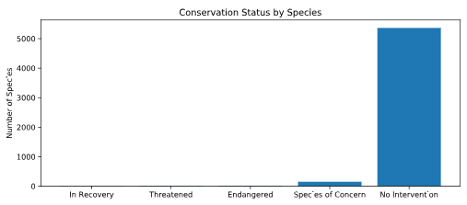
Species Data Summary
'Mammal' 'Bird' 'Reptile' 'Amphibian' 'Fish' 'Vascular Plant' 'Nonvascular Plant'
Species.csv., the primary data set leveraged for this research, contained a few key variables that I was able to analyze including
The scientific name of each species
The common names of each species
The species conservation status
Analysis of the data demonstrated that there were 5,541 unique species Overall, most species were not protected (see below)

Slide 4
Significance tests
Through further analysis of the data, I was able to understand the protected status across classes of animals, which could then be used in a chi2 test to evaluate signnicance across animal protection statuses. The protected status of each animal class is as follows -
mammals (17% protected)
birds (15% protected)
reptiles (6.4% protected)
amphibians (8.9% protected)
fish (8.7% protected)
vascular plants (1.1% protected)
nonvascular plants (1.5% protected)
A chi2 test analyzing the significance between the protected status of mammals and birds resulted in a p-value of .68 – demonstrating that the results are not significant and due to chance.
I conducted another chi2 test to understand whether the difference in protection status between reptiles and mammals was also significance. The P-Value of this test was .038 – another demonstration of significance. We can also conclude that the difference in protection % between reptiles and mammals is not due to chance. Mammals are more likely to be protected than reptiles.

Slide 5
Recommendation
Because chi2 tests revealed that mammals are statistically more likely to be protected than reptiles, I recommend that conservationists focus more efforts on mammals than reptiles.
The park service does not need to focus additional efforts on birds at this time.

Slide 6
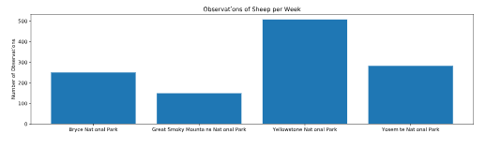
Foot and Mouth Study – Sheep
Knowing that foot and mouth disease is a key issue for conservationists across our great national parks, I was able to do some further analysis that could be leveraged for conservation efforts.
Through the data set observations.csv, I was able to merge the park conservation and species data against a file containing observations of each species across national parks. In this analysis, I focused on sheep species. See below for a chart demonstrating the observed sheep at the 4 different national parks within the data set.

Slide 7
Foot and Mouth Study – Sheep continued
I was given a subset of data to help determine how many observations and over how long of a period we would need to determine whether the current report sightings of foot and mouth disease were generalizable and if those metrics wer likely to persist. Using the following metrics we were able to make conclusions on how long two parks would need to observe sheep in order to make that determination –
Baseline conversion: 15
Statistical significance: 90%
Minimum detectable effect: 33.33333
Sample size per variant: 870
Through this analysis, I determined that Bryce Canyon would need to observe sheep for 3.48 weeks to make this determination and Yellowstone would need to observe for 1.72 weeks.

